Slide 1
An Analysis of Calgary Satisfaction Data and Safety
Data 601
(L01-5)
Olatomi Adigun, Gigi Chung, James Oblea, Jericho Pantony, Michaela Reyes
Faculty of Science and Graduate Studies
October 10, 2023

Slide 2
Introduction
Notes:
When I first arrived in Calgary, I vividly recall my landlord handing me the keys to my basement suite with a simple wish of 'Good Luck.' At that moment, I thought it was merely a friendly gesture, considering it was my first significant move since starting my undergraduate journey. However, as the first night unfolded, I quickly realized that the road ahead was filled with unexpected challenges.
The city seemed alive with sirens, ambulances, boisterous neighbors, and even unsolicited knocks at my door well past midnight during my initial week. It became evident that as a newcomer, my perception of 'home' depended on numerous factors far beyond the assurances of my landlord.

Slide 3
Topic of Choice and Interest
Provide information to newcomers regarding the factors that contribute to satisfaction levels in Calgary:
Our project aims to evaluate the satisfaction levels reported by current Calgary residents in the year 2022 and gain insights into the factors that contribute to their satisfaction
End user: Newcomers in Calgary
Notes:
My experience highlighted the challenges that newcomers may face, and this is not unique: as calgary continues to face a population surge, newcomers often grapple with the same uncertainties I faced. Our objective is to streamline this process. In this project, we aim to delve into the levels of satisfaction among Calgary residents and uncover the multifaceted factors that contribute to their overall contentment."

Slide 4
Datasets
Fall Survey of Calgarians (2022) | Community Crime Statistics (2022)
Survey on Satisfaction rates across services in Calgary, along with safety satisfaction Telephone Survey (random sample ages 18+) Metadata spreadsheet Variables of interest Demographics (age, gender, household income) Geographical data (ward) Safety levels (Overall, neighbourhood) Satisfaction levels (Overall) | From Calgary Police Services: includes crime rates by neighbourhood and type 2017-2023, filtered 2022 for consistency Variables of interest Date (2022) Type of crime (...) Geographical data (ward)
Notes:
"To achieve this goal, we utilized several datasets, including the Fall Survey of Calgarians. This survey captures satisfaction rates across various services along with safety in Calgary. This survey is performed annually by telephone and is randomly sampled for ages 18+. Additionally, there is a metadata spreadsheet that describes the dataset and it’s variables. Our variables of interest include demographics, geographical data, safety and satisfaction levels.
We also supplemented a Community Crime Statistics dataset which includes crime rates by neighbouhood from 2017 to present. We filtered the data to only include 2022 for consistency, and linked this dataset based on geographical data.

Slide 5
Guiding Questions
Which area(s) in Calgary has the highest satisfaction level and why?
How does satisfaction vary among different demographic groups (e.g. age, gender, income, education) in different areas of Calgary?
How safe do Calgarians feel and what areas report higher safety levels? Does safety correlate with satisfaction levels?
Can we find relationships between community crime statistics and reported levels of satisfaction on safety?
Notes:
I will continue with the guiding questions:
1. Our project aims to identify the areas in Calgary with the highest satisfaction levels and why.
2. We'll also explore how satisfaction varies among demographics like age, gender, income, and education.
3. Examining perceived safety and its correlation with satisfaction across neighborhoods is another focal point.
4. Lastly, we'll analyze community crime statistics to find potential relationships with reported levels of safety satisfaction.
The answers to these questions will help provide valuable insights for enhancing community well-being in Calgary.

Slide 6
Guiding Question 1
Which area(s) in Calgary has the highest satisfaction level?
Notes:
I will be sharing our finding on Guiding question 1 which I had the privilege to work on. Which area(s) in Calgary has the highest satisfaction level?

Slide 7
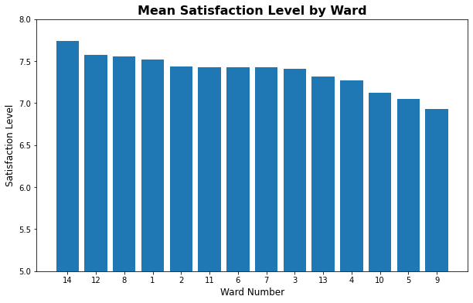
Notes:
This barchart illustrates the average satisfaction level by ward. Upon plotting it, we observed they are quite similar, little or no variation of the satisfaction level amongst the wards. As a result, we opted to scale the satisfaction levels

Slide 8
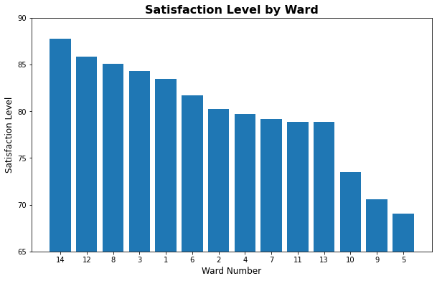
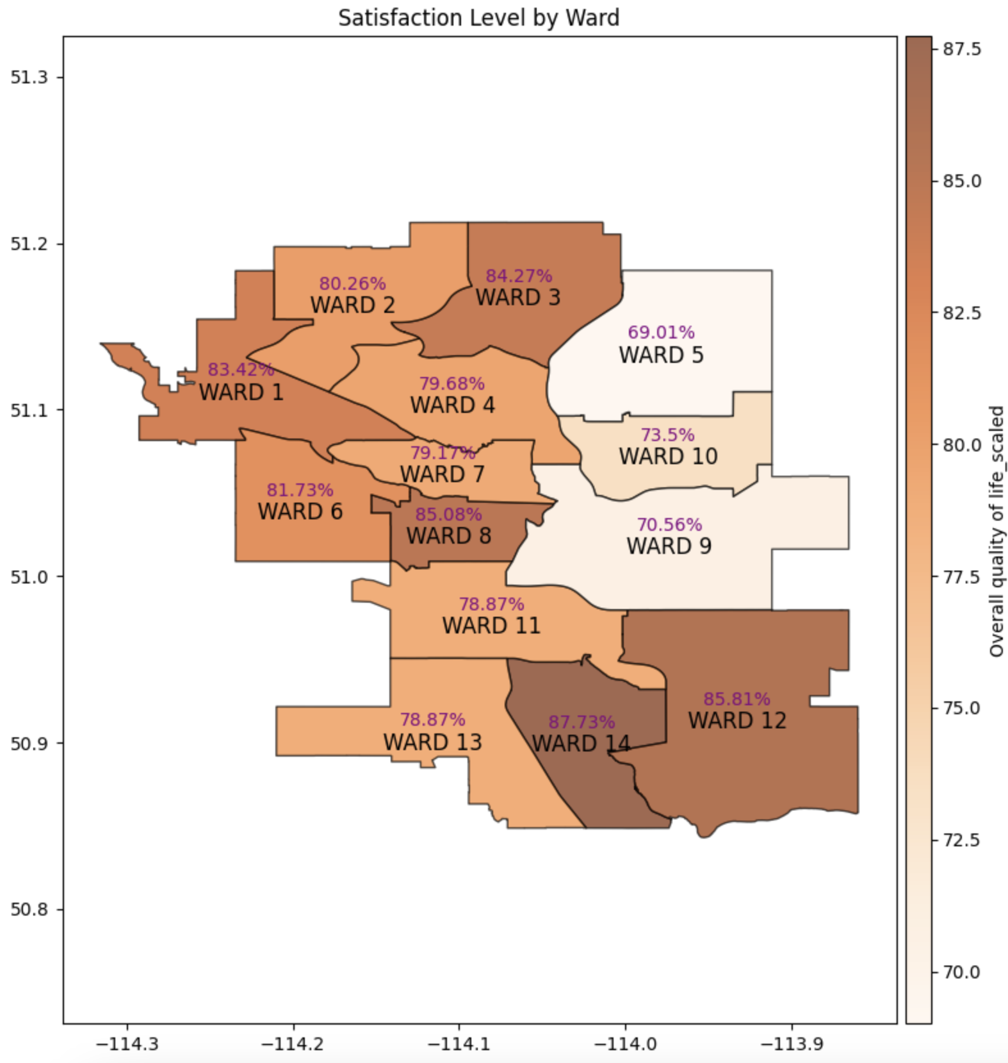
Notes:
"We simplified the satisfaction level into a binary scale, categorizing responses from 7 to 10 as 'good,' assigned a value of '1,' and all other responses as '0.' Next, we calculated the proportion of 'good' responses for each ward and visualized it.
On the left, you'll see a bar chart displaying the Mean Satisfaction level by ward, based on our new scaled satisfaction level. On the right, we've represented the same data using a Choropleth map. In this map, darker shades indicate higher satisfaction levels. Notably, Wards 14, 12, and 8 emerge as the areas with the highest satisfaction levels."
We will now dive deeper with the other guiding questions

Slide 9
Guiding Question 2
How does satisfaction vary among different demographic groups (e.g. age, gender, income, education) in different areas of Calgary?

Slide 10
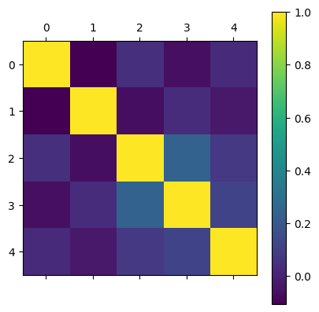
0 - Gender
1 - Age group
2 - Household Income
3 - Highest level of Education
4 - Overall Quality of Life

Slide 11
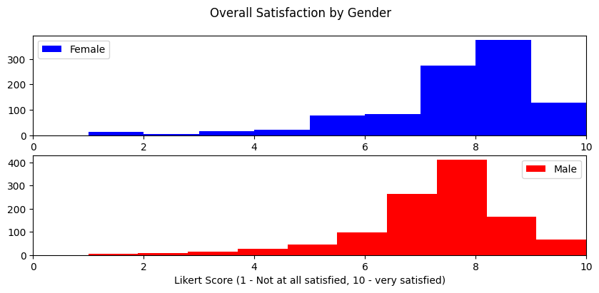
Notes:
what was excluded
distribution
central tendency, spreadness, skewness

Slide 12
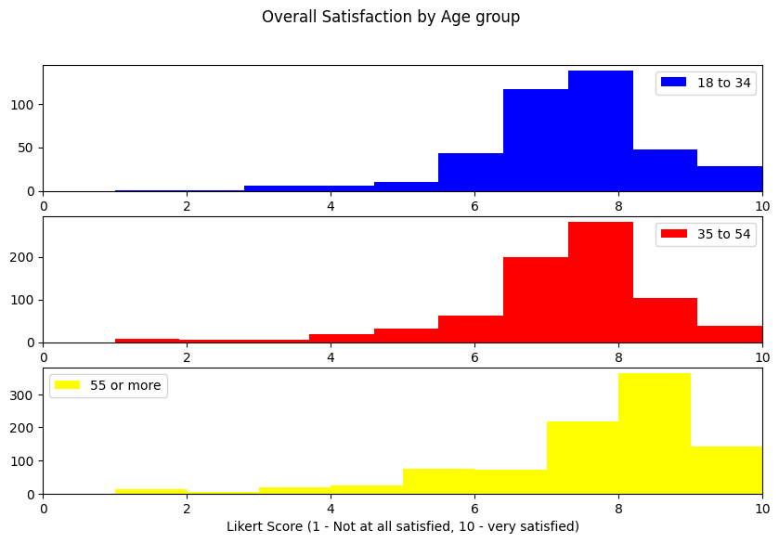
Notes:
similar shape across all
compare y-axis

Slide 13
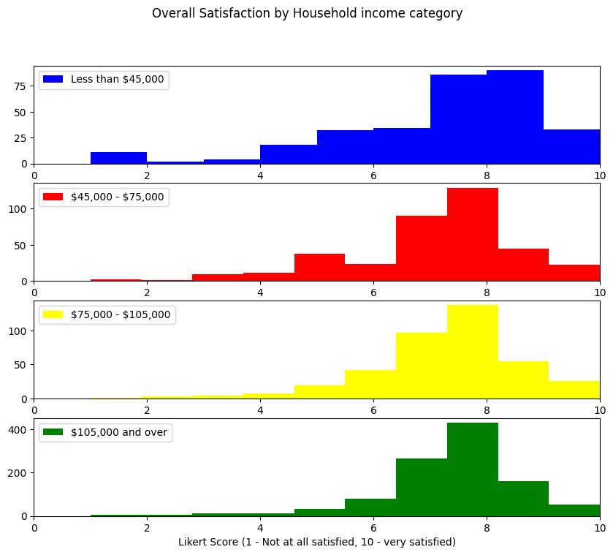
Notes:
compare y-axis
variability?

Slide 14
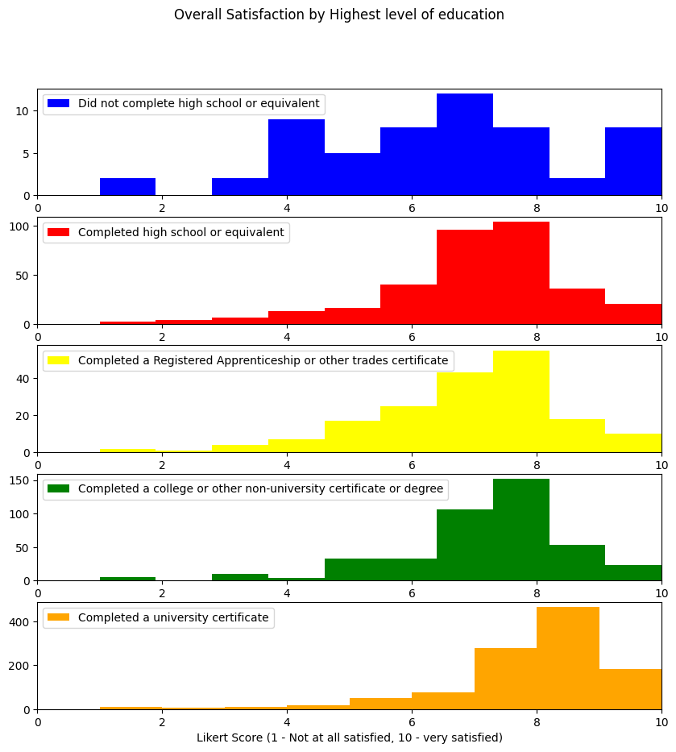
Notes:
definitely variability -> sampling bias
y- axis

Slide 15
Guiding Question 3
How safe do Calgarians feel and what areas report higher safety levels? Does safety correlate with satisfaction levels?
Notes:
Our third guiding question is “How safe do Calgarians feels and what areas report higher safety levels? Does safety correlate with satisfaction levels?”. As safety is of utmost concern, particularly for newcomers seeking secure and welcoming environments for themselves and/or their families, our analysis aims to understand the safety disparities among different wards in Calgary and how these perceptions correlate with residents' overall satisfaction.

Slide 16
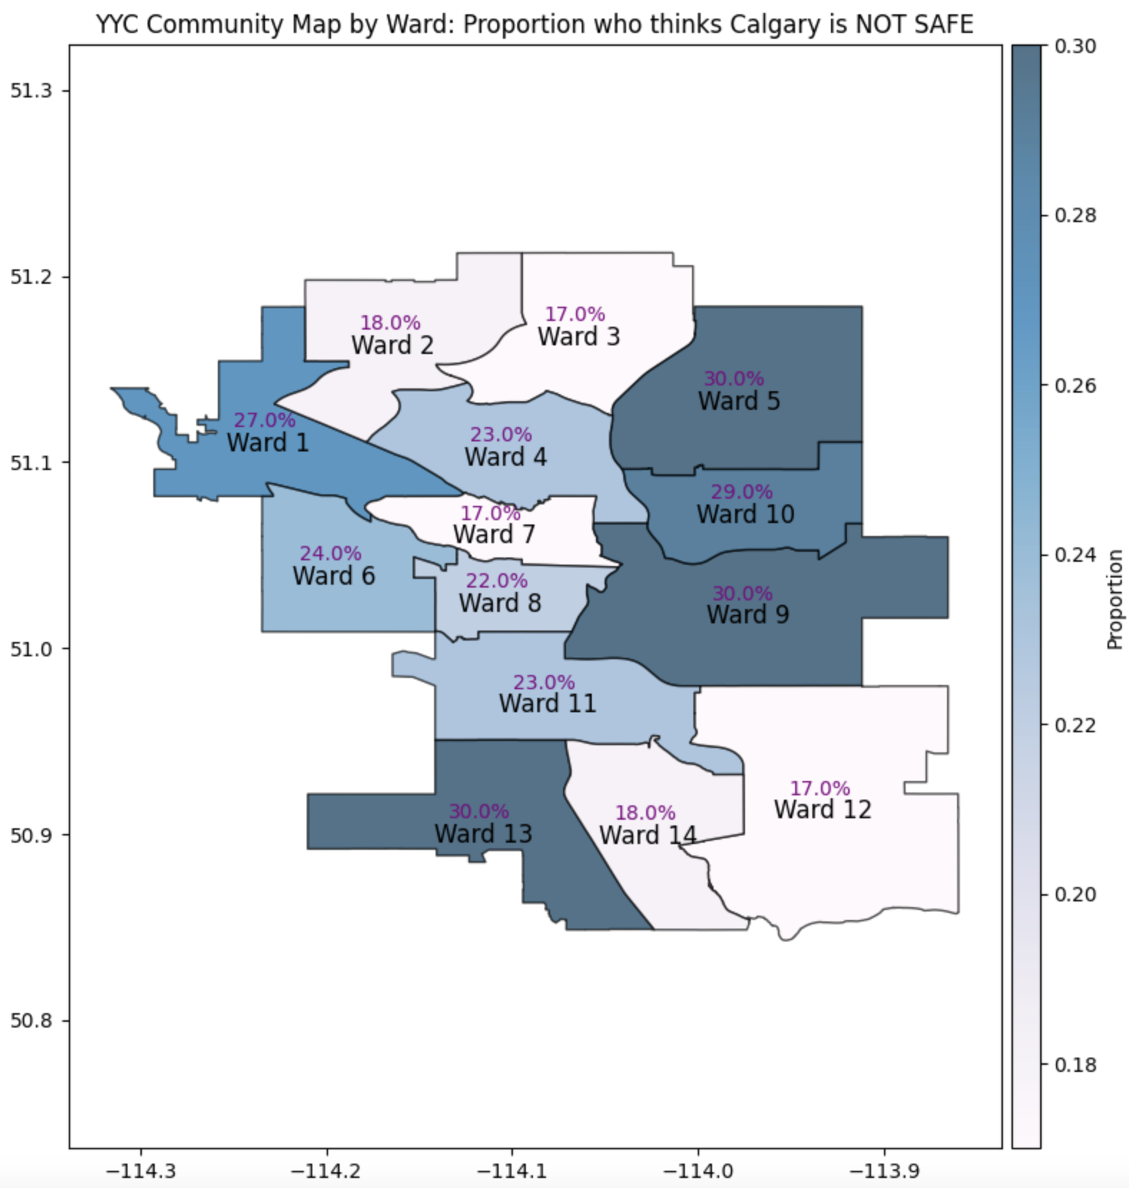
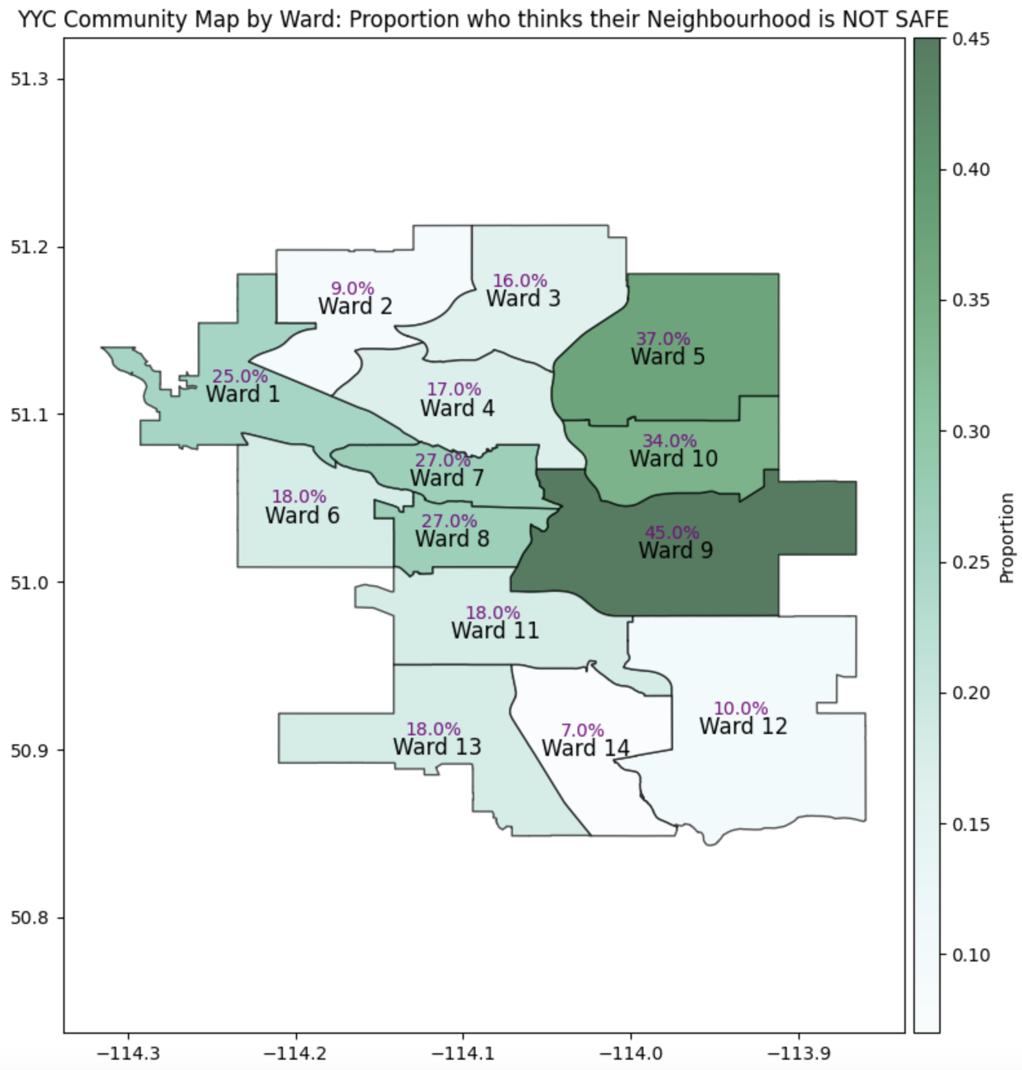
Notes:
To assess Calgarians’ perception on safety and to find out which area has the highest safety level, we have created heatmaps that show the proportions of Calgarians who feel that Calgary as a whole and walking alone in their neighbourhood after dark is not safe based on their respective wards. Looking at both graphs, we can see that for Wards 2,3 and 12, people feel more safe and for Wards 5, 9, and 10, people feel less safe. It is also interesting to see that for Ward 13, there’s some inconsistency here where they feel their neighbourhood is pretty safe but doesn’t feel the same for Calgary as a whole

Slide 17
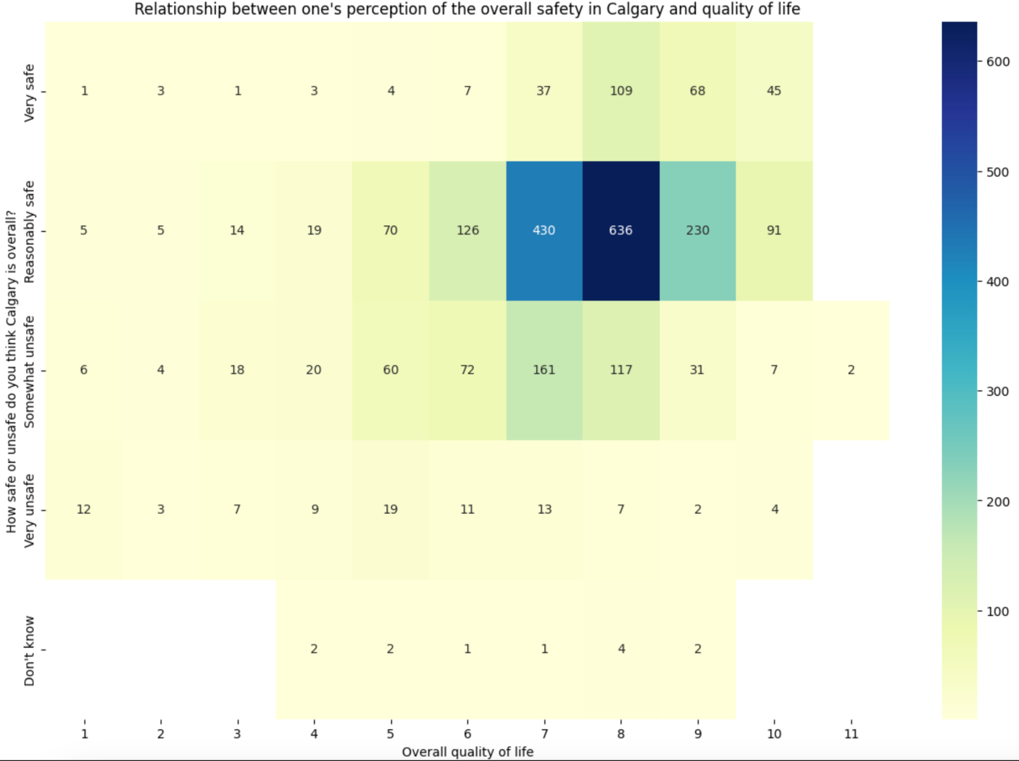
Notes:
We also did a heatmap to find if there’s a correlation between safety and the satisfaction levels where the darker shades represent a higher count. We first look at for the overall safety in Calgary and we can see that as one’s perception of safety increases, their view on quality of life also increases.

Slide 18
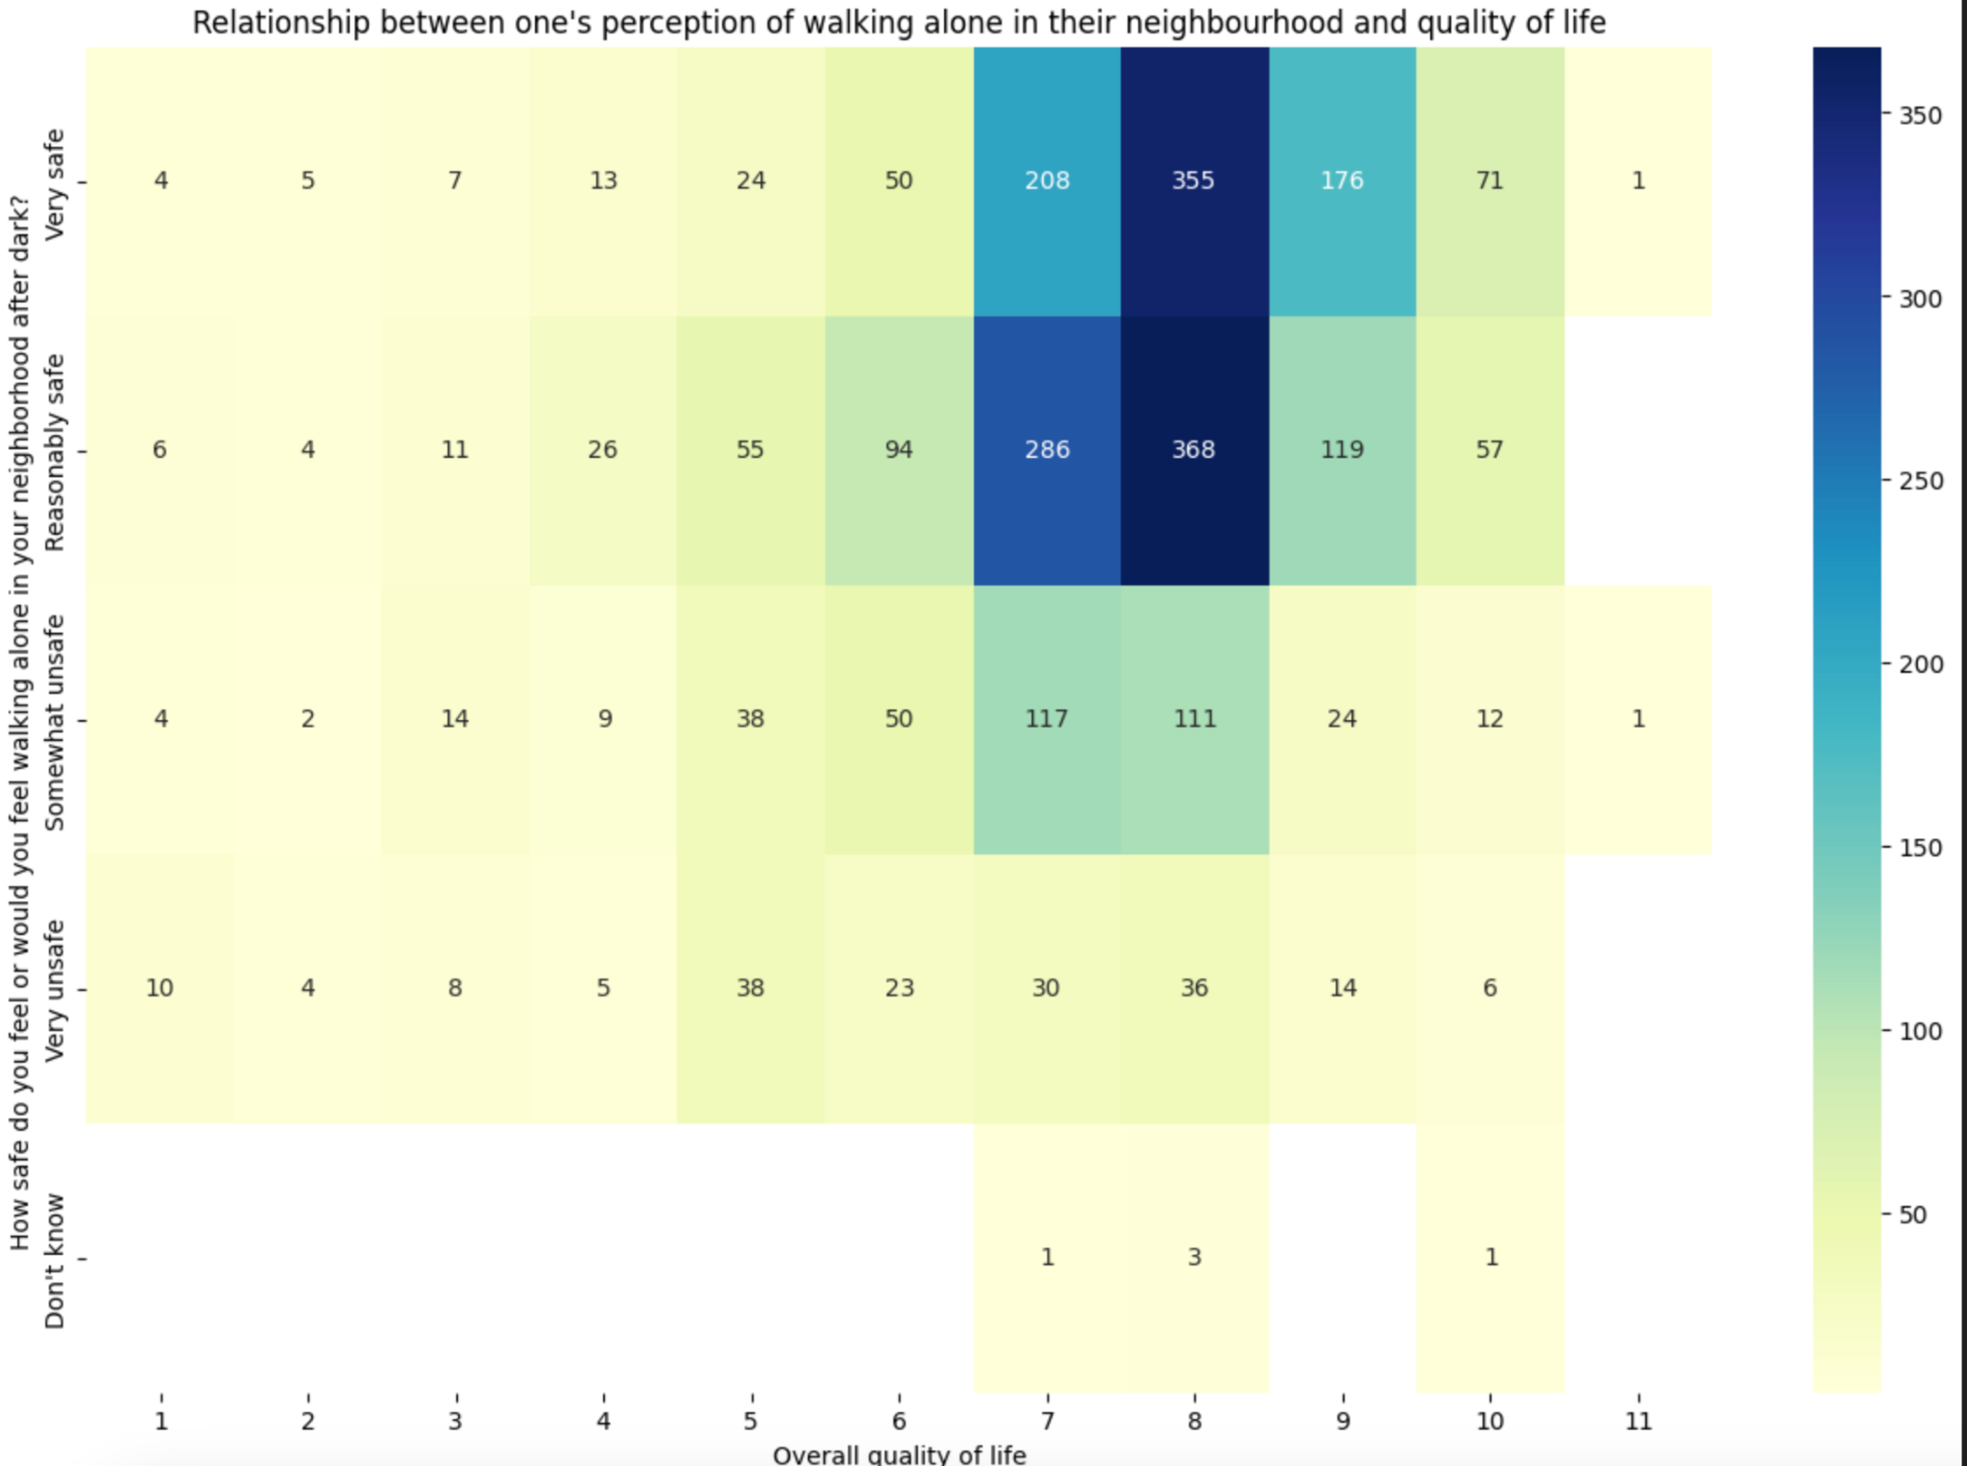
Notes:
Similarly, for walking alone in their neighbourhood after dark, we can see the same. Therefore, as a whole, safety seems to correlate with satisfaction levels.

Slide 19
Guiding Question 4
Can we find relationships between community crime statistics and reported levels of satisfaction on safety?
Notes:
here we come our forth guiding question, “Can we find relationships between community crime statistics and reported levels of satisfaction on safety?” We have further analyzed the community crime dataset for year 2022 to see if there’s any relationship between the actual crime counts and the reported levels of satisfaction on safety in the survey.

Slide 20
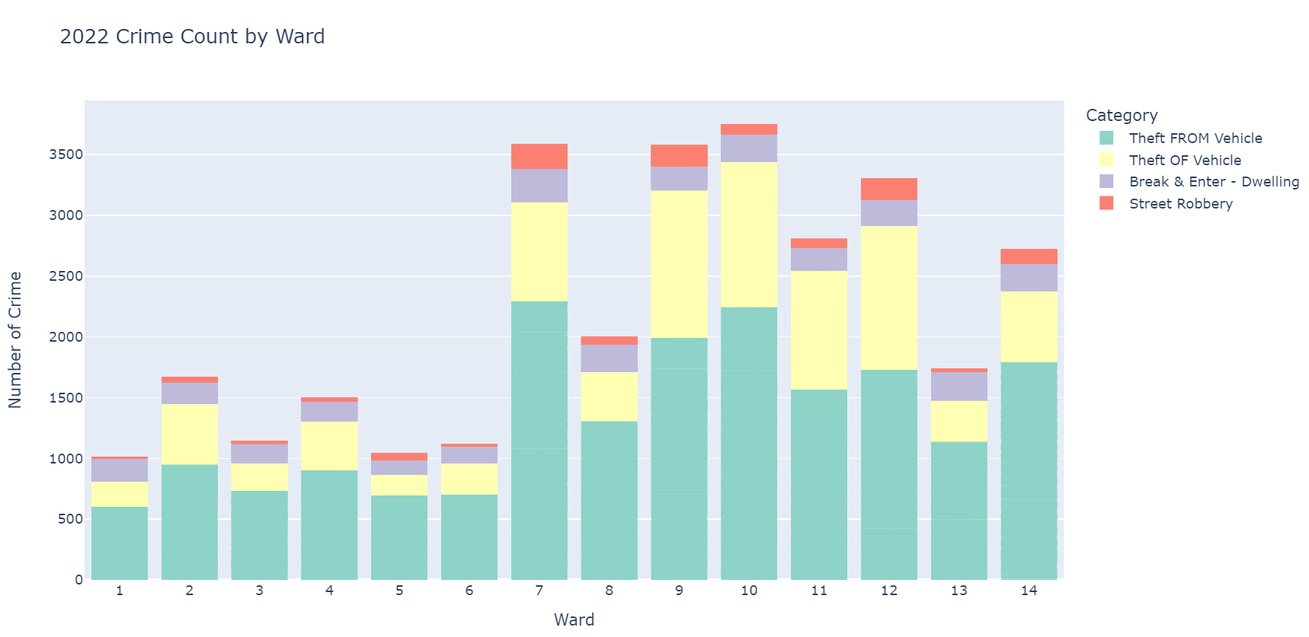
Notes:
For this analysis, we’ve looked into the crime count for 2022 in 14 wards by narrowing down to only 4 crime categories, which we believed to be more relevant in this context. This bar graph shows the crime count by category in each ward. We can tell that wards 1, 5 and 6 are the places with the lowest crime counts, while 7,9,10 are the most unsafe wards. (In addition, it’s quite interesting to see that the proportion of street robbery is higher in some wards than the others, like 7,9,12)
The 4 categories are Theft from vehicle, Theft of vehicle, break & enter - dwelling and street robbery.

Slide 21
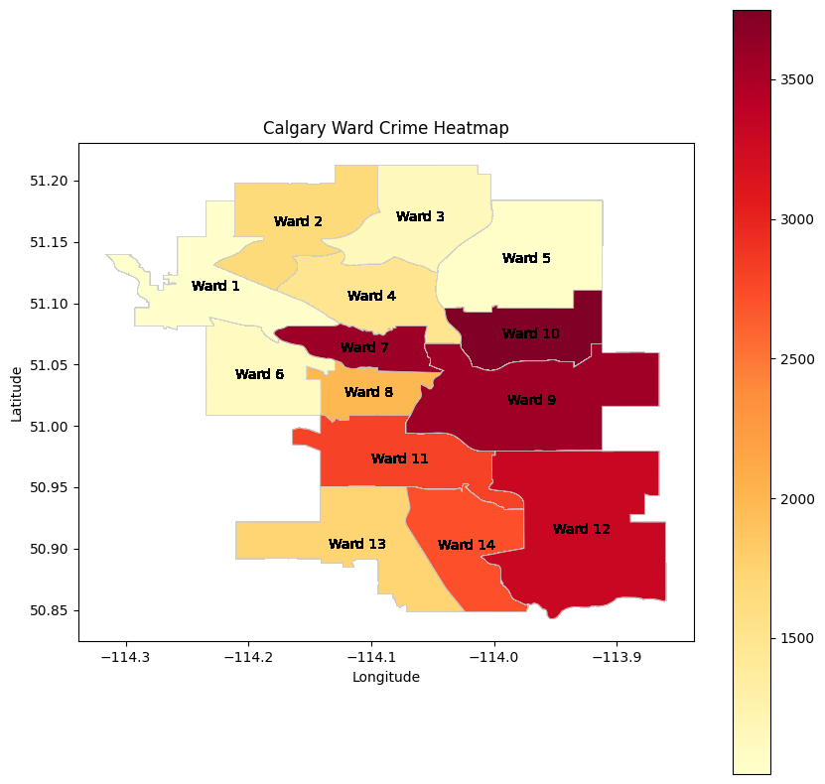
Notes:
Furthermore, we have created a heatmap to show the intensity of crime counts in Calgary geographically. The dark the color , the higher the crime counts are in the wards. Again, wards 1 and 5 are the most safe, while 10 is the most unsafe in terms of the crime statistics. We then compared it with the survey result of “how safe respondents feel in their neighborhood” that we created for guiding question no. 3. By comparing these maps, we would like to see if residents in a ward with higher crime rates would feel more “unsafe” in their neighborhood. Here we can find the consistency between the 2 dataset for the most unsafe wards like 9,10. As well as for the most safe wards like 1,2,6. However, it’s interesting to find that wards like 12 and 14 have higher crime rates but the residents feel safe, and for ward 5, there’s a low crime rate but they don’t feel as safe.

Slide 22
Notable Roadblocks…
Technical difficulties
Difficulty finding a tool to work collaboratively on code
Real-time collaboration
Version-control and naming-convention discrepancies
Information overload
Main dataset contains an abundance of questions
Time-constraints
Notes:
There were three main roadblocks throughout our analysis:
Firstly, we encountered a couple of technical difficulties. Our primary challenge was finding a tool that would enable all of our group members to collaborate effectively on code. Additionally, we faced issues in locating a program that offered real-time collaboration capabilities. Furthermore, at the outset of our project, we discovered disparities in version control practices and naming conventions for variables and datasets. To mitigate this, we reached a consensus to standardize our variables, and this allowed us to work on our individual code components independently and later merge them seamlessly.
The second roadblock is related to our main dataset. With numerous variables to consider, we experienced scope creep and had to narrow our research focus. This also ties into our third roadblock, as we faced time constraints that prevented us from analyzing more of the dataset. [elaborate more? less]

Slide 23
References
https://data.calgary.ca/Help-and-Information/Fall-Survey-of-Calgarians-2022-/5geu-ar8w
https://data.calgary.ca/Health-and-Safety/Community-Crime-Statistics/78gh-n26t

Slide 24
Thank you!
Notes:
That concludes the end of our presentation and we thank you for listening to our video…

